Slide 1
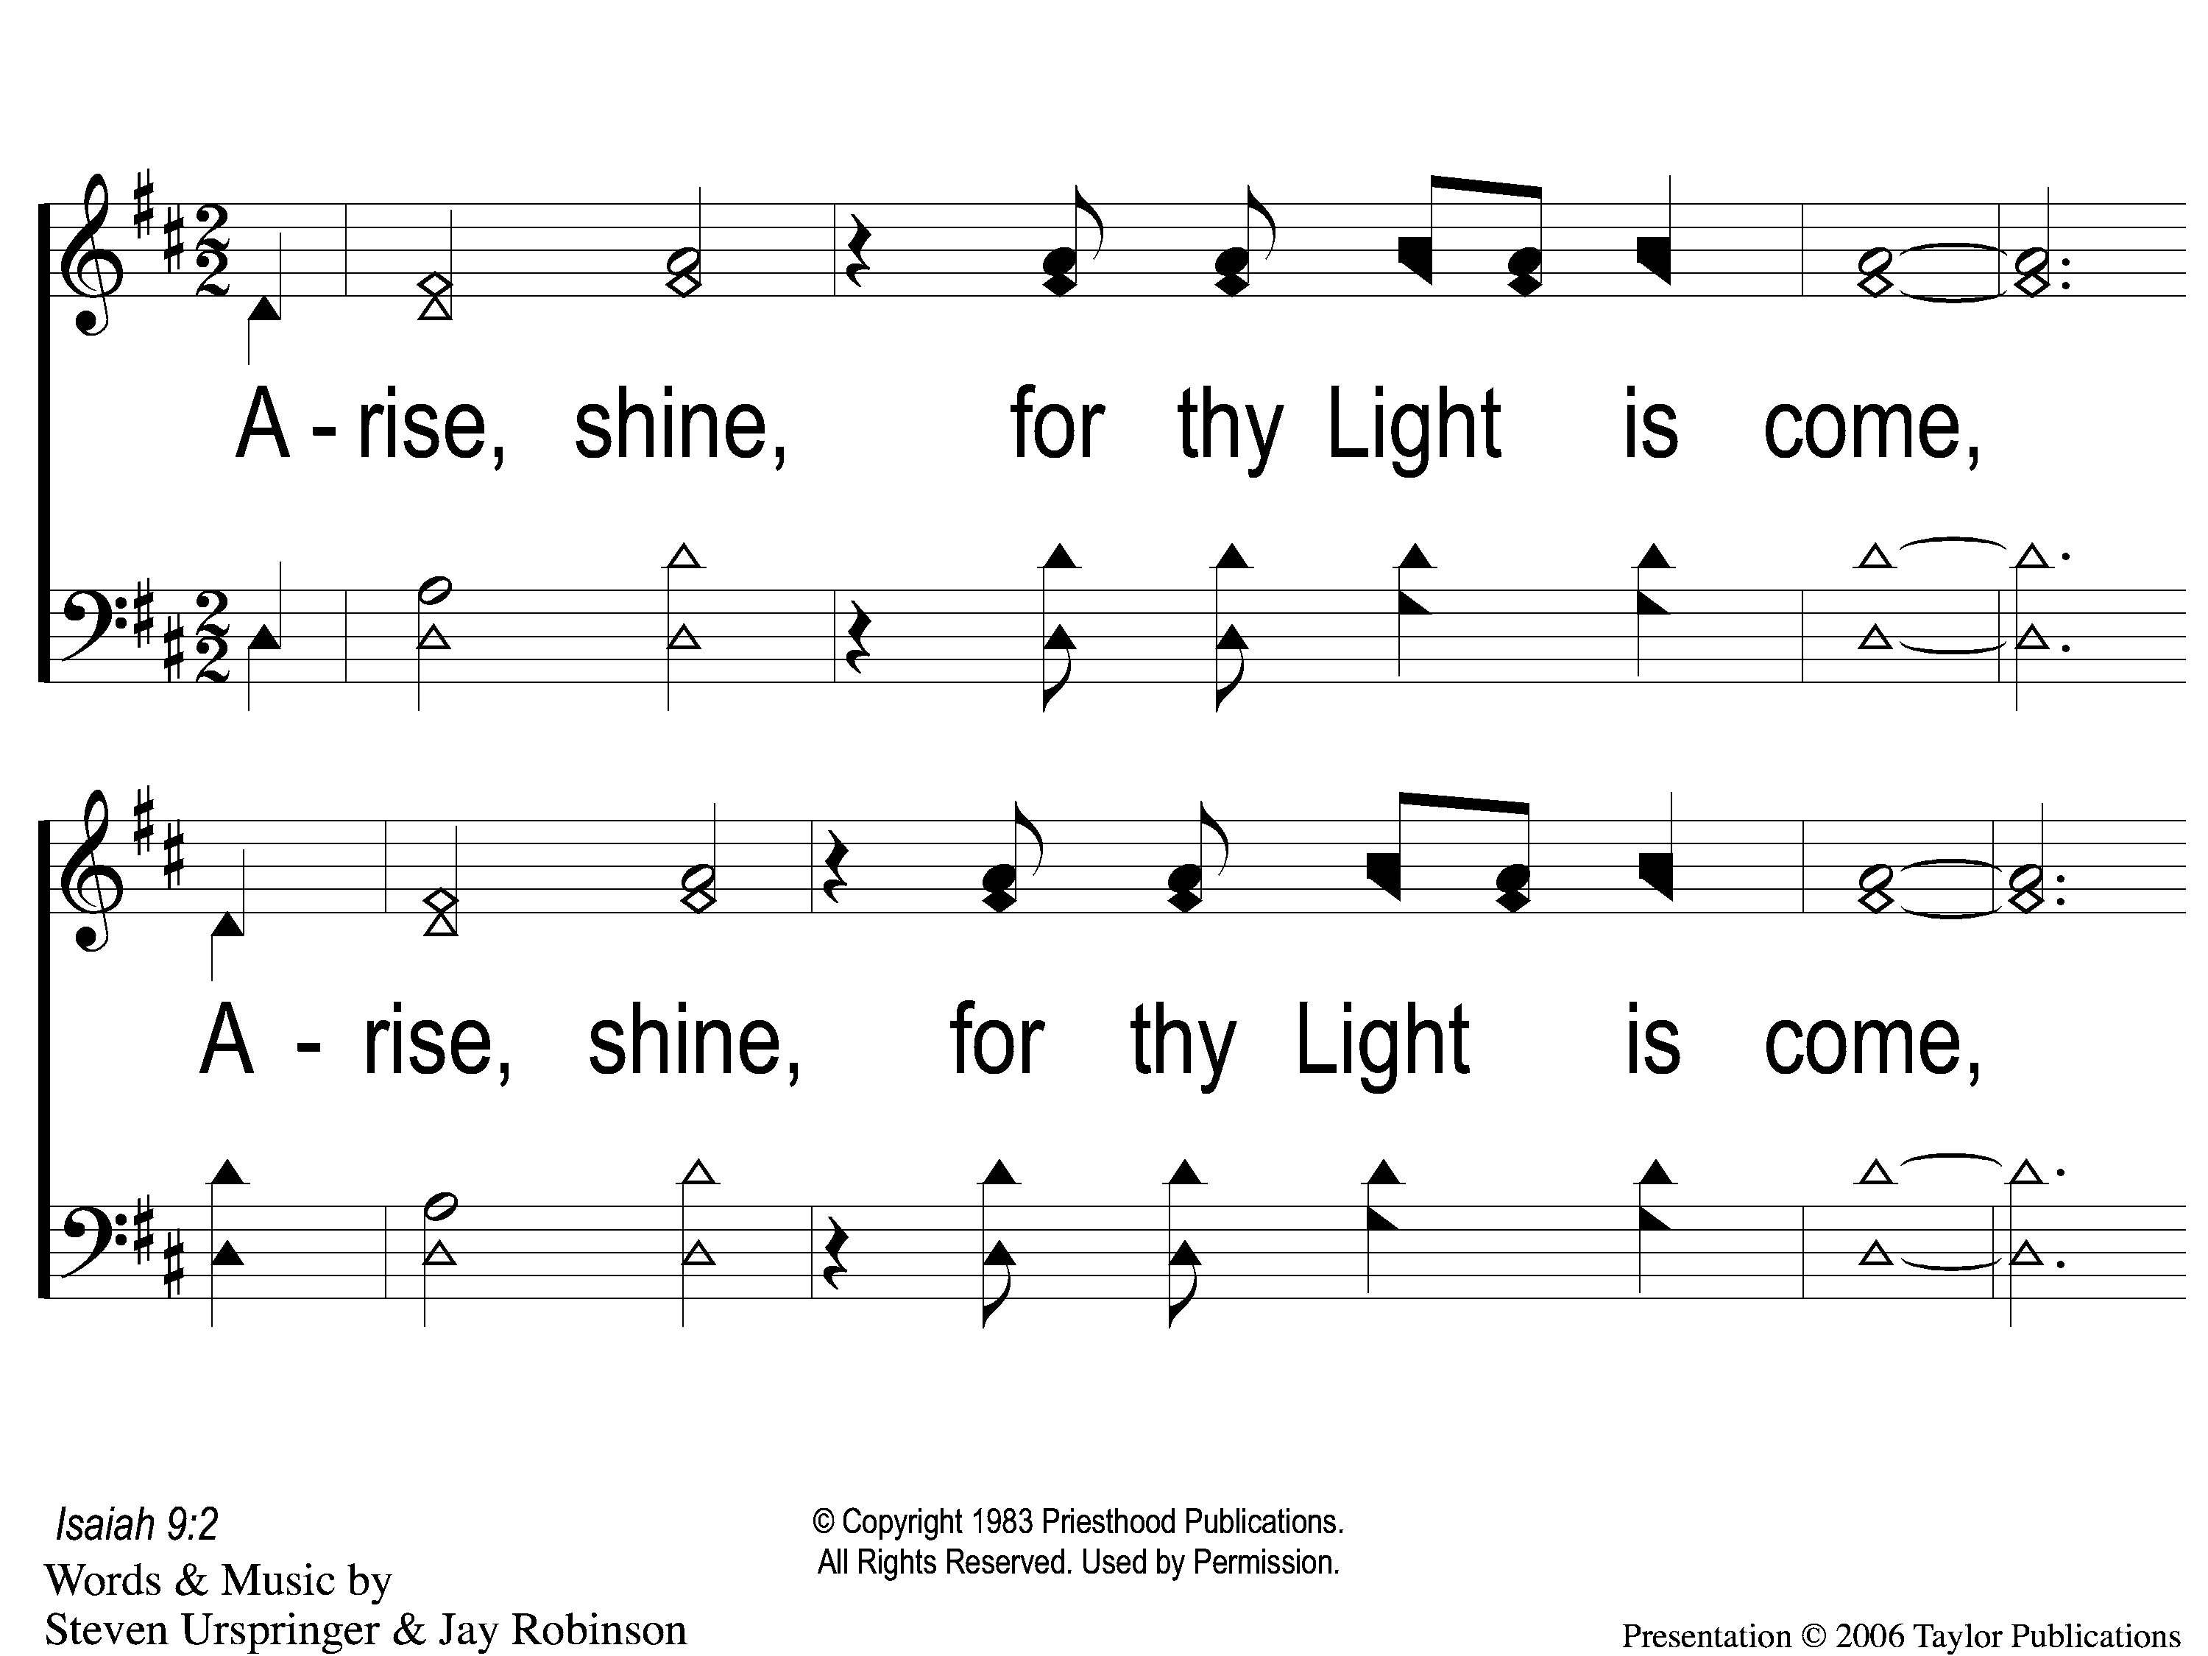
1 Arise Shine
Arise, Shine
819

Slide 2
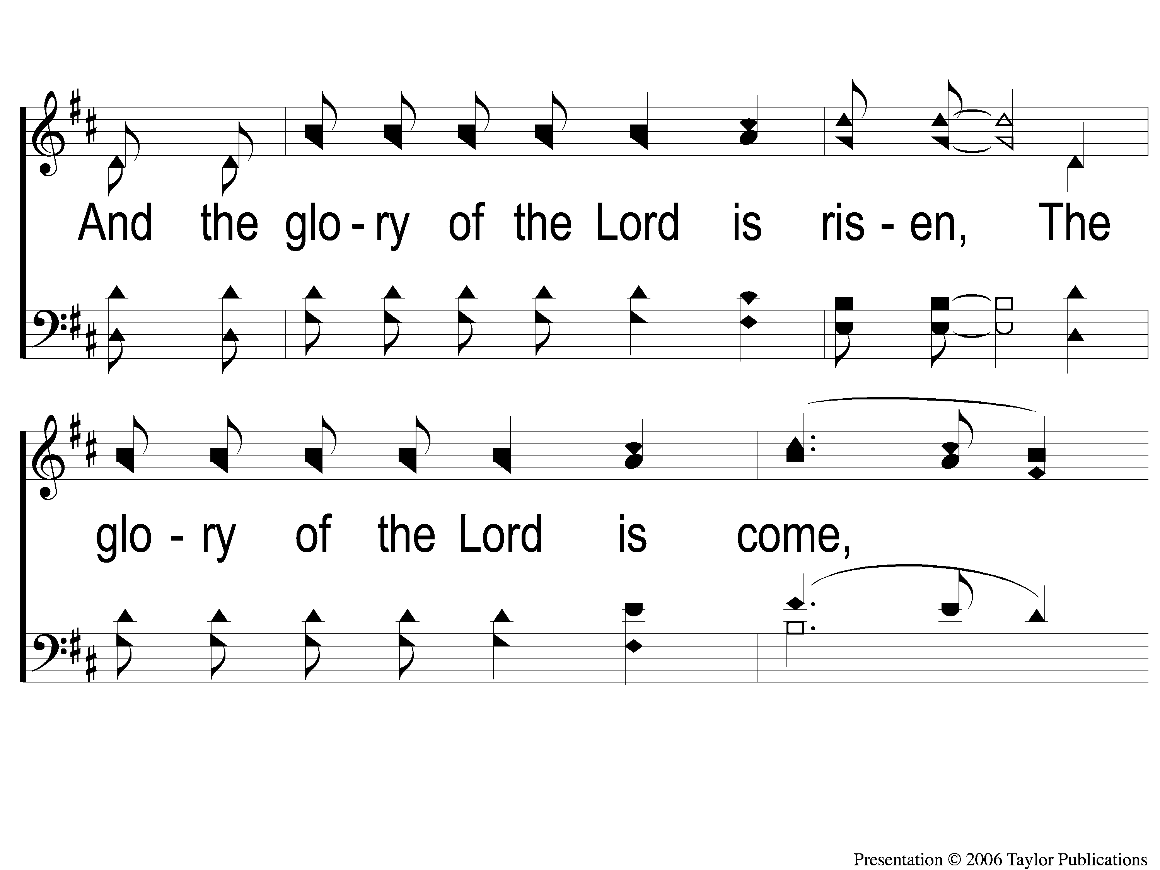
2 Arise Shine
Arise, Shine
819

Slide 3
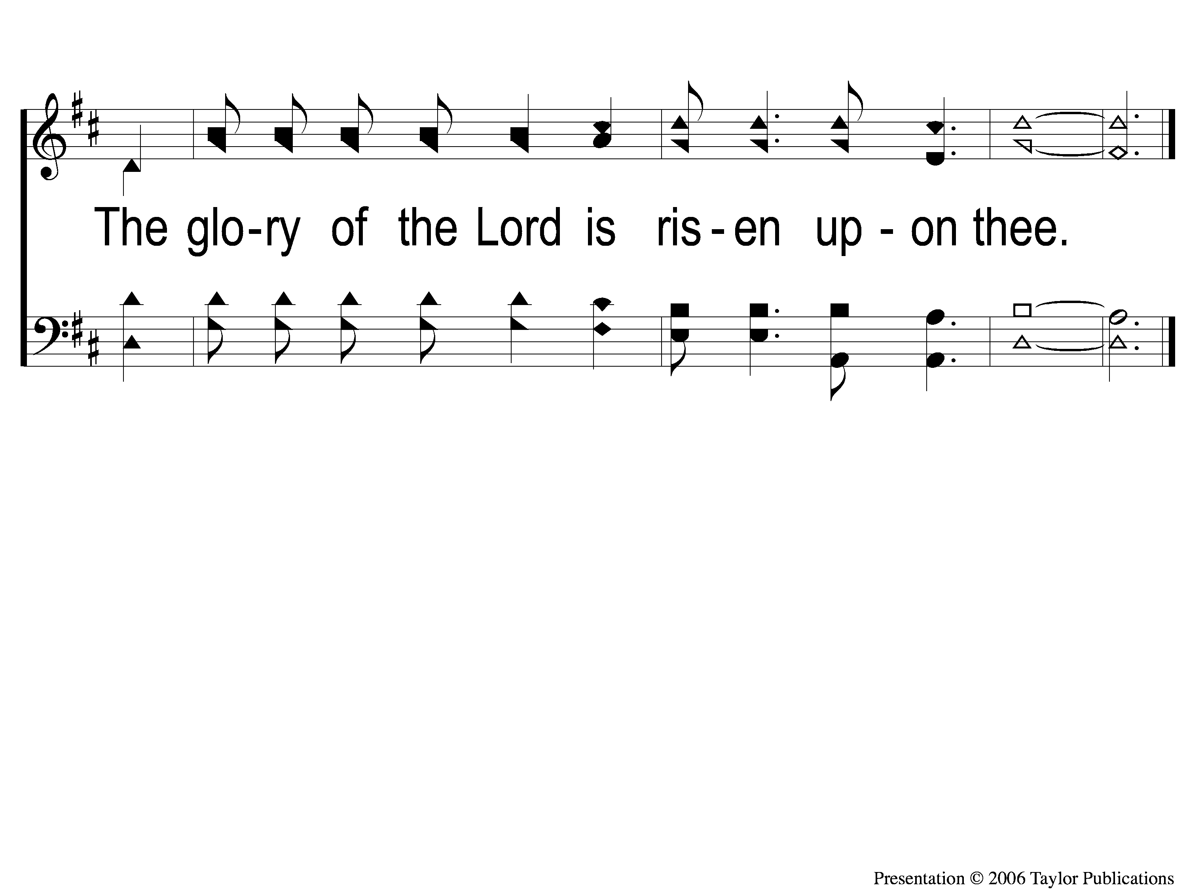
3 Arise Shine
Arise, Shine
819

